Slide 1
Assessment of Air Quality Associated with Socioeconomic Status in China
IST 5520 Project
By Wenyuan Cui and Hao Wu
Department of Mechanical and Aerospace Engineering
May 2nd,2018

Slide 2
Outline
Introduction
Data Collection
Data Manipulation and Visualization
Regression Analysis
Predictive Modeling
Conclusions and Future Improvement

Slide 3
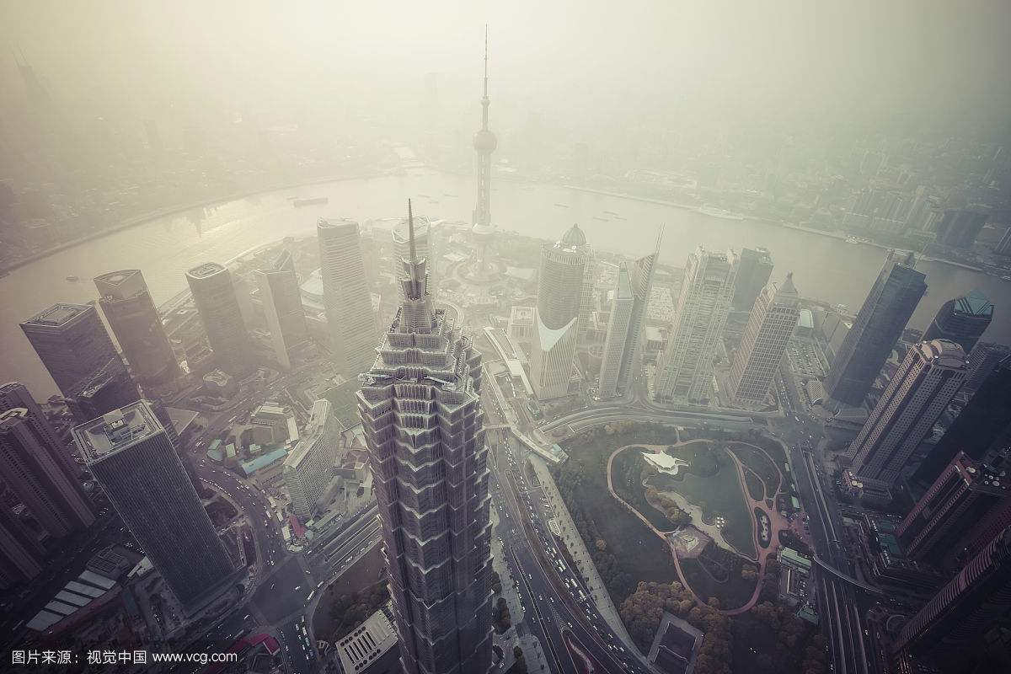
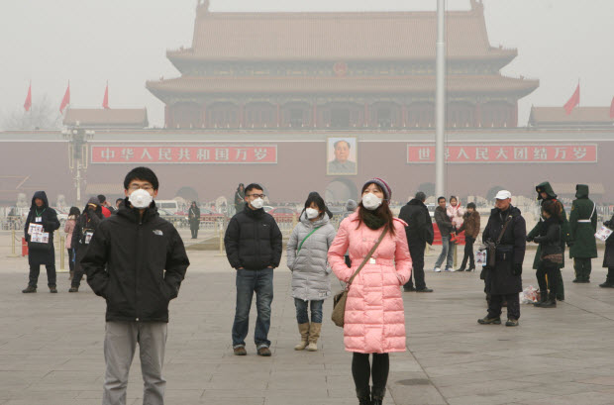
Introduction
What is air pollution and its cause?
The presence of toxic chemicals such as PM2.5,PM10,CO,SO2,etc in the air
Caused by human activities such as mining , industrial work, transportation, construction, etc.
Why the air quality analysis matters?
Environment being polluted
Millions of people suffer from health risk due to air pollution
What are benefits of this project?
Provide insights into the air quality with GDP and energy consumption
Governments and environmental agencies to take measures of protecting our environment

Slide 4
Objectives
To find the cause of air pollution in China by analyzing air quality data of five Chinese cities from 2015 to 2017
Summarize and visualize the air quality index across the time and cities
Link the correlationship between air quality and air pollutants
Build up the predictive modeling of air quality index

Slide 5
Data Source and Collection
Data Source
Kaggle.com
PM2.5 daily from China National Environmental Monitoring Station
Data Information
Sample size about 450 MB
22 variables
5 major Chinese cities
Time duration 2015-2017
The information of the data
  year: year of data in this row
  month: month of data in this row
  day: day of data in this row
  hour: hour of data in this row
  PM2.5: PM2.5 concentration (mg/m^3)
  PM2.5_24h: PM2.5 concentration 24 hourly average (mg/m^3)
  PM10: PM10 concentration (mg/m^3)
  PM10_24h: PM10 concentration 24 hourly average (mg/m^3)
  AQI: air quality index real time value
  SO2: sulfur dioxide real time concentration (mg/m^3)
  SO2_24h: sulfur dioxide 24 hourly average (mg/m^3)
  NO2: nitrogen dioxide real time concentration (mg/m^3)
  NO2_24h: nitrogen dioxide 24 hourly average (mg/m^3)
  O3: ozone real time concentration (mg/m^3)
  CO: carbon monoxide real time concentration (mg/m^3)
  CO_24h: carbon monoxide 24 hourly average(mg/m^3)
  DEWP: Dew Point (Celsius Degree)
  TEMP: Temperature (Celsius Degree)
  HUMI: Humidity (%)
  PRES: Pressure (hPa)
  cbwd: Combined wind direction
  Iws: Cumulated wind speed (m/s)

Slide 6
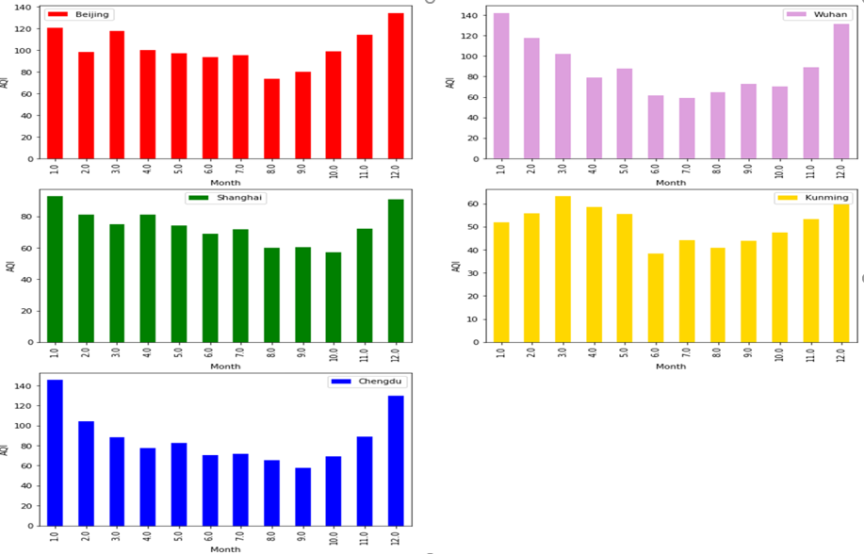
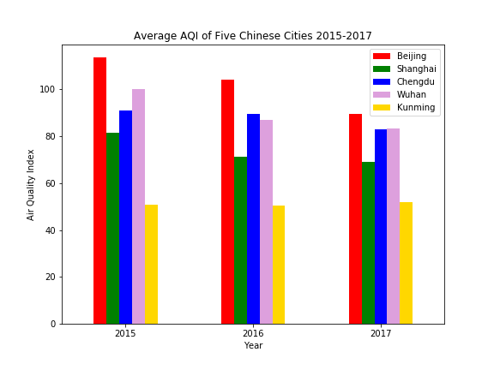
Data Manipulation and Visualization
The overall AQI trend is decreasing for those five cities from 2015 to 2017.
Beijing air quality is the worst among the five cites and Kunming has the best air quality.
Five cites show the same distribution which AQI is high in winter and low in summer.

Slide 7
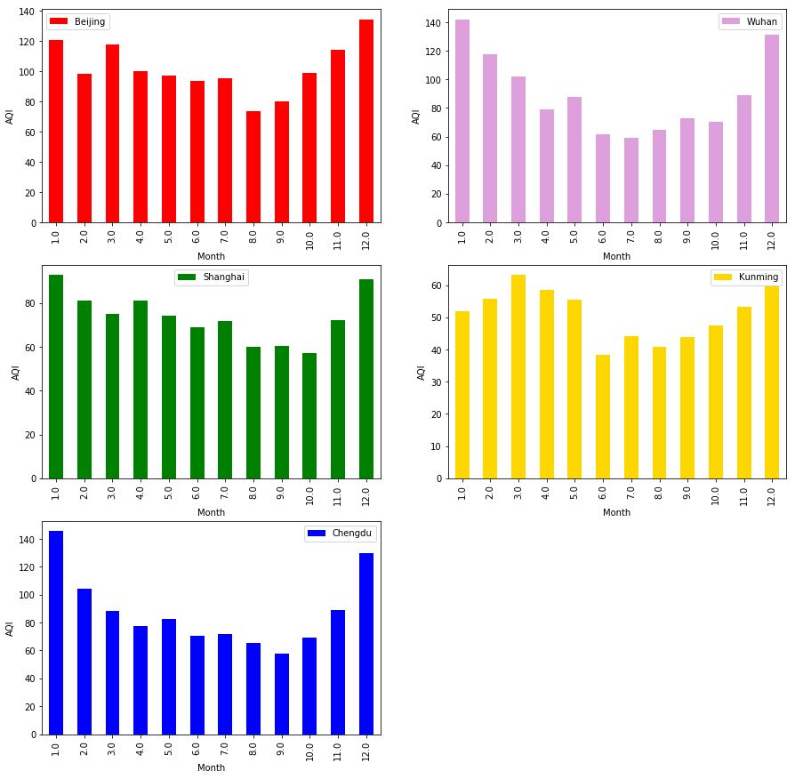
Data Manipulation and Visualization

Slide 8
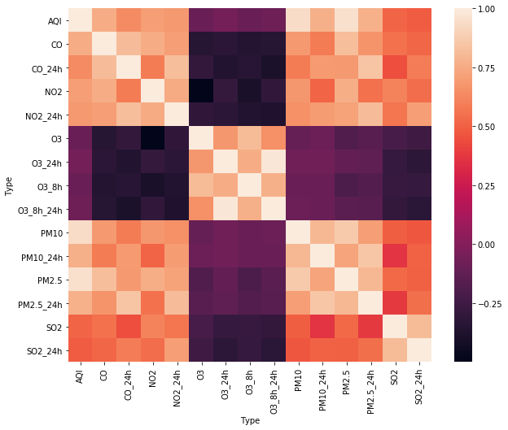
Data Manipulation and Visualization

Slide 9
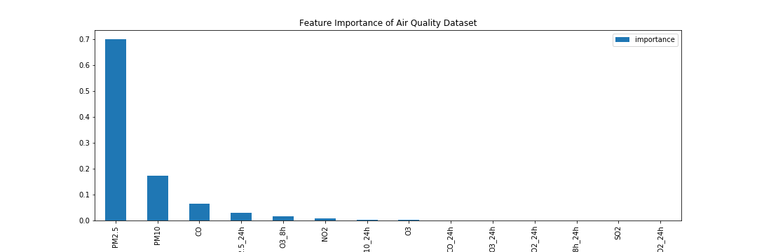
Data Manipulation and Visualization
Notes:
Based on the feature selection, we can see that the important value of PM2.5 is the highest, PM10 ranks the second score of importance score, CO and O3 rank the 3rd and 4th important features. This result is consistent with the correlation analysis.

Slide 10
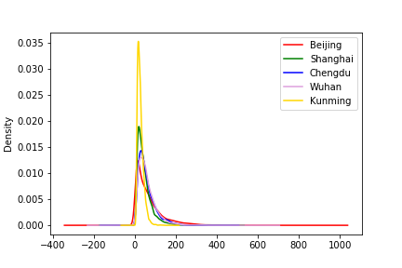
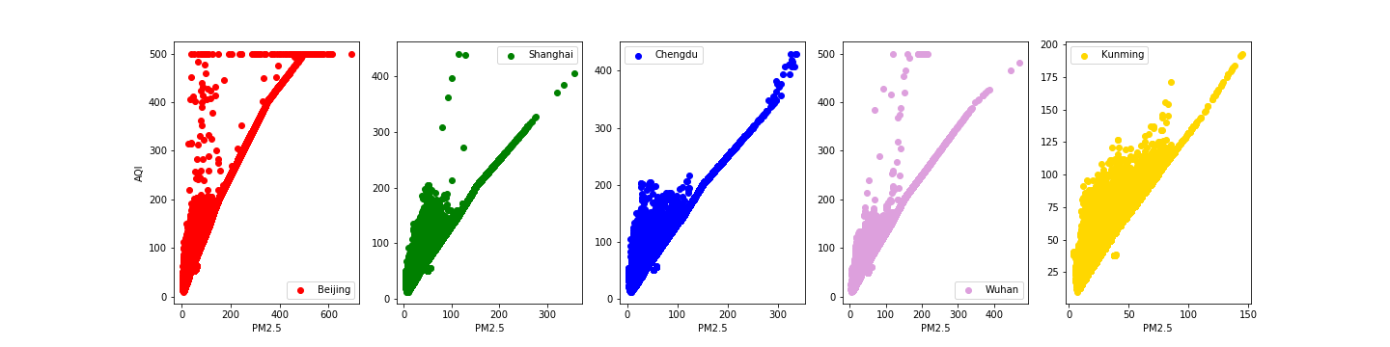
Data Manipulation and Visualization
Beijing has the largest range of PM2.5, which means that the variance of PM2.5 is the highest.
Shanghai and Kunming have more uniform density distribution of PM2.5 and the fluctuations are more stable.
AQI and PM2.5 have strong linear relationship in five cites

Slide 11
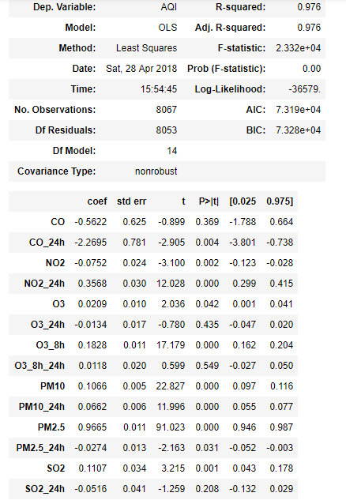
Regression Analysis
PM10, PM2.5,O3 and SO2 have a positive effect on AQI. Increasing 1 unit in PM2.5 concentration would increase AQI by 0.9655 units after controlling for other factors. The positive effect of PM10, PM2.5,O3 and SO2 on AQI is statistically significant (P<0.001).
Predictors including CO, O3_24h and SO2_24h do not have statistically significant effects on AQI (p-values > 0.05).

Slide 12
Predictive Modeling
Machine learning method to build model
  K-Nearest Neighbors
  Regression Tree
  Neural Network
  Random Forest
Normalization
Split data
Create the design matrix
Tune the parameters using the GridSearchCV
Fit the model
Use the best parameter to fit the model
Predict our model using test dataset

Slide 13
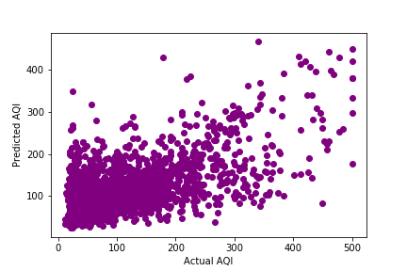
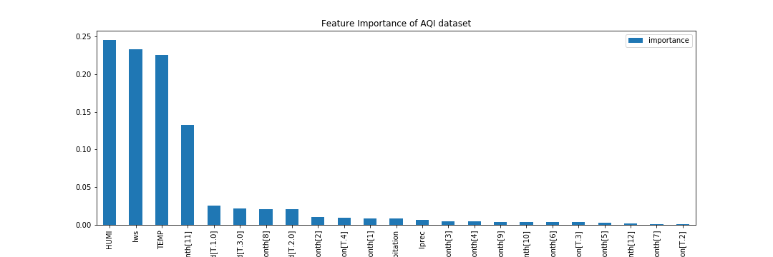
Predictive Modeling

Slide 14
Conclusions
The overall air quality has been improved from 2015 to 2017. Summer time shows a better air quality among the four seasons.
Beijing has the worst air quality index while Kunming has the lowest air quality index in the past three years.
PM2.5, PM10 and CO concentration have the strong impact on the air quality index (AQI) based on the correlationship analysis and random forest feature selection.
According to the regression analysis, R squared value of the model is 0.976, which means a strong linear relationship between the AQI and other factors.
It shows that the random forest has the highest predative performance.

Slide 15
Future Improvement
Recommendation:
Restrict the new cars growth.
Develop the environmental energy-efficient vehicles.
Shut down the polluting factories.
Reduce burning fossil fuels like coal.
Benefits:
Find the cause of influencing the air quality by analyzing the data.
Provide the useful information to the government and environmental protection agency to conduct relative research.
  Improve the lifehood of the people and reduce the risk of diabetes, heart disearse and cancer.

Slide 16
Thank You!

